Slide 1

AIA Healthiest
Schools
Challenge
Student-led project and competition
Toolkit
This flexible toolkit guides you through running a project to improve school health and wellbeing. Share your story for a chance to win healthy prizes!
Subject: HPE
Ages: 5–12
Time: Varies depending on options chosen

Slide 2
About this toolkit
Teacher’s notes
About AIA Healthiest Schools
  AIA Healthiest Schools is a program of free-to-use teaching resources for schools across Asia Pacific.
  The program provides lessons and workshops that help young people aged 5–16 to learn about healthy habits and to plan and implement changes that help students, their schools and communities to be healthier and happier.
Developed with teachers
  This program has been developed in partnership with Hark and a panel of subject matter experts and practising teachers.
The AIA Healthiest Schools Challenge toolkit
  This toolkit will help you and your students to make a real difference to the health of your school community. It guides you through:
  assessing how healthy your school is now
  coming up with an action plan to make it healthier
  putting these ideas into practice.
Your project might be led by staff or a group of students – a single class, a new committee with volunteers or class reps, or an existing school council.
  In addition to this presentation, the toolkit includes two templates: a survey and an action plan.
Enter the AIA Healthiest Schools Challenge!
Tell us about your project for a chance to inspire other schools around the world and win some fabulous prizes!

Slide 3
Running your project
Teacher’s notes
  We suggest running a weekly session for three weeks to get your project started. You can then run regular check-in meetings for as long as needed to complete your project (we suggest at least a month).
Session | Overview | Session timings | Slides | Preparation and resources required
Session 1: Introduction and Research | How healthy is your school now? Do a quick class poll, interviews or survey. | 30-45 mins | 5-17 | Printed copies of slide 16 (one copy per pair)
Session 2: Ideas | Brainstorm ideas for making your school community healthier. | 30-45 mins | 18-28 | Printed copy of each of slides 21-28 (one copy) Plain paper and pens
Session 3: Action plan | Review initial ideas and develop a plan | 30-45 mins | 29-32 | Action plan template (printed or on a computer)
Further sessions: Make a change | Progress check ins | 15-30 mins per meeting | 33-34
Final session: Share success | Share results with the school community and enter the AIA Healthiest Schools Challenge. | 60 mins | 35-36 | AIA Healthiest Schools Challenge entry form
  Not enough time for a full project? Take a look at the Quick Ideas Generator to help you come up with some quick wins in just an hour!

Slide 4
Entering the competition
Teacher’s notes
  To enter the AIA Healthiest Schools Challenge, you need to complete a simple form on the website covering the following areas:
Judging criterion | Details
Engagement | Wide involvement of staff, students and local community
Breadth of work | The number of/breadth of initiatives across or within the pillars: healthy eating, activity, mental wellbeing, health and sustainability
Impact | The difference the program has made to students and the wider school community
Future plans | How you plan to take your creative ideas forward, embed them in the school and use the prizes if won
Prizes
Win a range of exciting prizes to make your school even healthier, for example expert visits school trips and kit.

Slide 5

Session 1a:
Introduction
Healthy School toolkit
Content: Introduction to creating a project to make your school community healthier.
Time: 5-10 minutes at the start of your first session

Slide 6
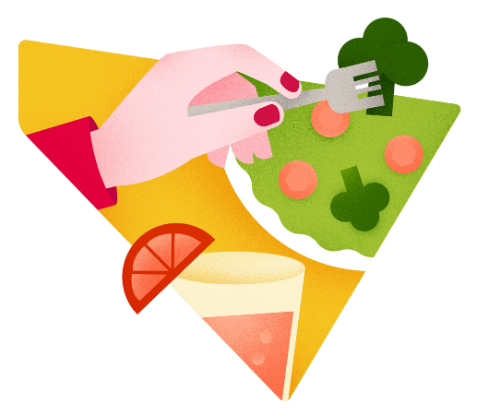
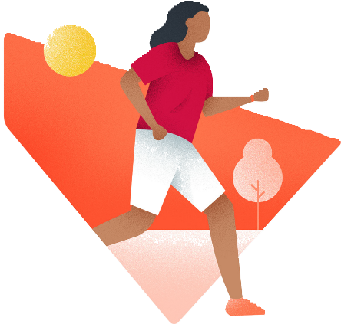


What are the four ‘pillars’ of a healthy lifestyle?
Introduction
Healthy eating
Active lifestyles
Mental wellbeing
Health and sustainability
  We are going to make a plan to make our school healthier and put it into practice!
Notes:
Introduce or remind students of the ‘four pillars’ of a healthy lifestyle: healthy eating, an active lifestyle, looking after our mental wellbeing and including sustainability (or thinking about the health and happiness of the earth itself).
Now it’s time to put their understanding into action and help others!

Slide 7
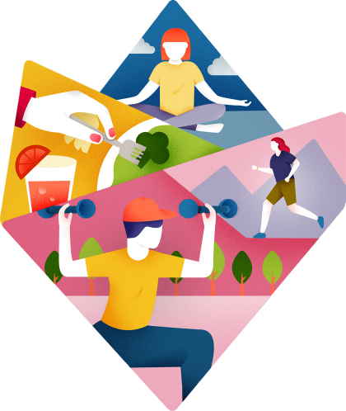
What makes a healthy school?
Introduction
  Imagine your school community is really healthy. What does that look and feel like?
Everyone has the knowledge they need to make healthy choices.
The whole school community is included:
staff, families and even people living in the local area.
Everyone has opportunities to:
• eat healthy food
• be active
• care for mental wellbeing
• take care our planet.
Barriers that might stop people making healthy choices are removed.
  Wherever your school is now, you have the power to make a difference!
Click to reveal

Slide 8


Who can we help to be healthier?
Introduction
Ourselves
Our families
Our school
Our teachers
Others in our community
‹#›
Notes:
Highlight that what we do to help our school can also inspire others to improve their health and wellbeing! Who could students help?
Give each student a clean sheet of paper (or students could use an online tool like Google Jamboard) and ask them to write their name at the centre. Then, ask students to write ideas around their name for anyone who they could help to be healthier. Share ideas and use them to identify any groups they could help, like younger children, elderly people etc.
Challenge: Some students could then choose one person or group on their sheet and think of that person as now at the centre – who could this person then help and inspire? Could they reach different people?

Slide 9
What we’re going to do
Introduction
  We are going to create an action plan to make our school healthier, one step at a time.
Session 1:
Research
Session 3:
Action plan
Final session:
Share success
Session 2:
Ideas
Further sessions:
Make changes

Slide 10

What skills will we need?
Introduction
  To make a difference, we will need to…
…work as a team
…listen
…be creative
…communicate
…be organised and pay attention to detail
…solve problems!
‹#›

Slide 11
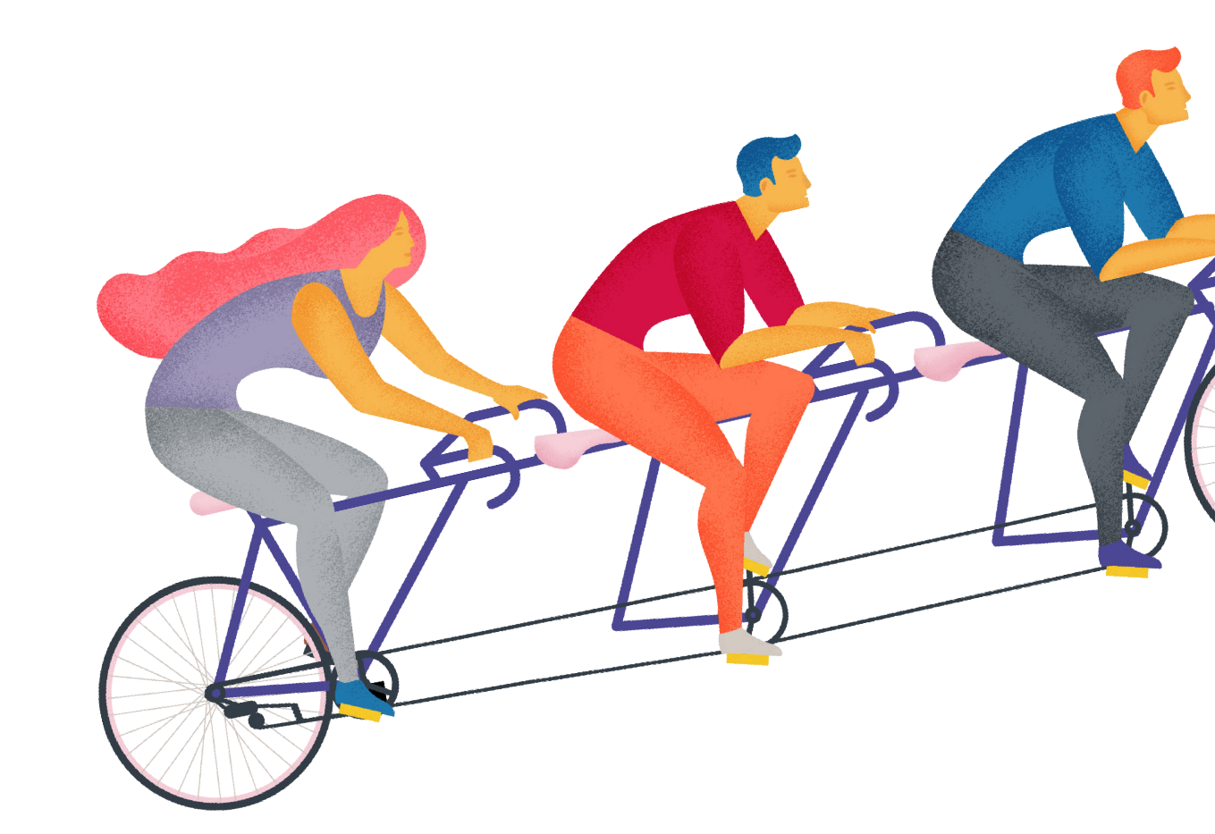
Session 1b:
Research
Healthy School toolkit
Content: Find out how healthy your school community is right now!
Time: 20-40 minutes (with optional extension)
Skills: Listening, organisation and attention to detail
Notes:
Resources
Discussion guide (printable slide 16)
Template survey

Slide 12

Why do we do research?
Research
You are going to do some research to find out how healthy your school community is right now. This will help you put together your healthy school action plan.
Examples
Research tells us what we are doing well already and where changes are most needed.
We were already eating healthily, but we were not active enough.
It will help us measure what differences we make.
Most of us weren’t active every day at the start, but now we are.

Slide 13

How can we do research?
Research
  There are many ways you can do research:
  Option 1: Group discussion
  Option 2: Interviews
  Option 3: Surveys
Top tips
The more research you can do, the more difference you will make.
Repeat your research after you have made changes to see if they have helped people to make healthier choices.
Focus on one option to start with – but you can do all of them if you have more time.
‹#›

Slide 14
Option 1: Group discussion
Research
  Discuss the questions on each card.
Healthy eating
What do we eat at lunchtime?
Do we drink plenty of water?
Does everyone know what healthy eating means?
Active lifestyles
When are we active in the school day?
Could we be more active?
Do we get active at home?
Mental wellbeing
Are we getting
enough sleep?
Are there calm places
to go?
Who can we talk to
if we feel stressed?
Health and sustainability
Do we eat local
and seasonal food?
How many green spaces can we access?
Do we recycle everything possible?
Healthy eating
Active lifestyles
Mental wellbeing
Health and sustainability
Click to reveal

Slide 15

Option 2: Interviews
Research
  Interview people to get their views on how healthy your school is now and what could be improved.
  Think about interviewing other students, teachers, school leaders, caretakers, office staff and parents.
  Write a discussion guide to plan what you will say!
‹#›
Notes:
Explain to students that before conducting any interviews, they should decide how they will approach each person and what questions to ask them – this is called a ‘discussion guide’, like a plan for the interview, so they don’t forget anything and can hopefully come away with the information they need. Use the discussion guide templates (next slide) to help students structure their interviews.

Slide 16
Option 2: Discussion guide
Research
  Add your questions to create your discussion guide.
Introduction: Explain who you are and why you are doing the interview.
Main questions: What do people know, think or do about healthy lifestyles? Questions without a yes or no answer are best.
Warm-up: Ask a few questions about the person (e.g. job).
End: Thank the person you are interviewing and ask them if they have any questions for you.
Notes:
Printable slide

Slide 17

Option 3: Surveys
Research
  Conduct a whole-school survey to find out ‘where we are now’:
  What are people’s current habits?
  What do they think about how healthy your school is?
  How do people feel?
  What would they like to change?
  What do they find hard?
  How could we help them?
Who will you include in your survey?
What questions will you ask?
What will help you to make a good action plan?
Top tips
You can use the AIA Healthiest Schools survey template!
‹#›
Notes:
Ask students to suggest what questions a survey about this pillar might include (the survey template includes some example questions to get students started, including questions that help students to understand where your school is now – your current practice and impacts). Give students a few minutes to come up with some questions for their survey - using paper or online platforms as appropriate.
Support: Create a single survey together/set a short number of questions
Challenge: Ask each group to create their own survey. Discuss how else students could find out more about this pillar. For example they might make observations of people in your school or community, or interview people who can make decisions in this area, like a member of staff or community leader. Plan how students might carry out this additional research.

Slide 18

Session 2:
Ideas
Healthy School toolkit
Content: Generate ideas for making healthy changes
Time: 30-45 minutes
Skills: Creativity, communication, teamwork
Notes:
Resources
Large sheets of paper and pens

Slide 19
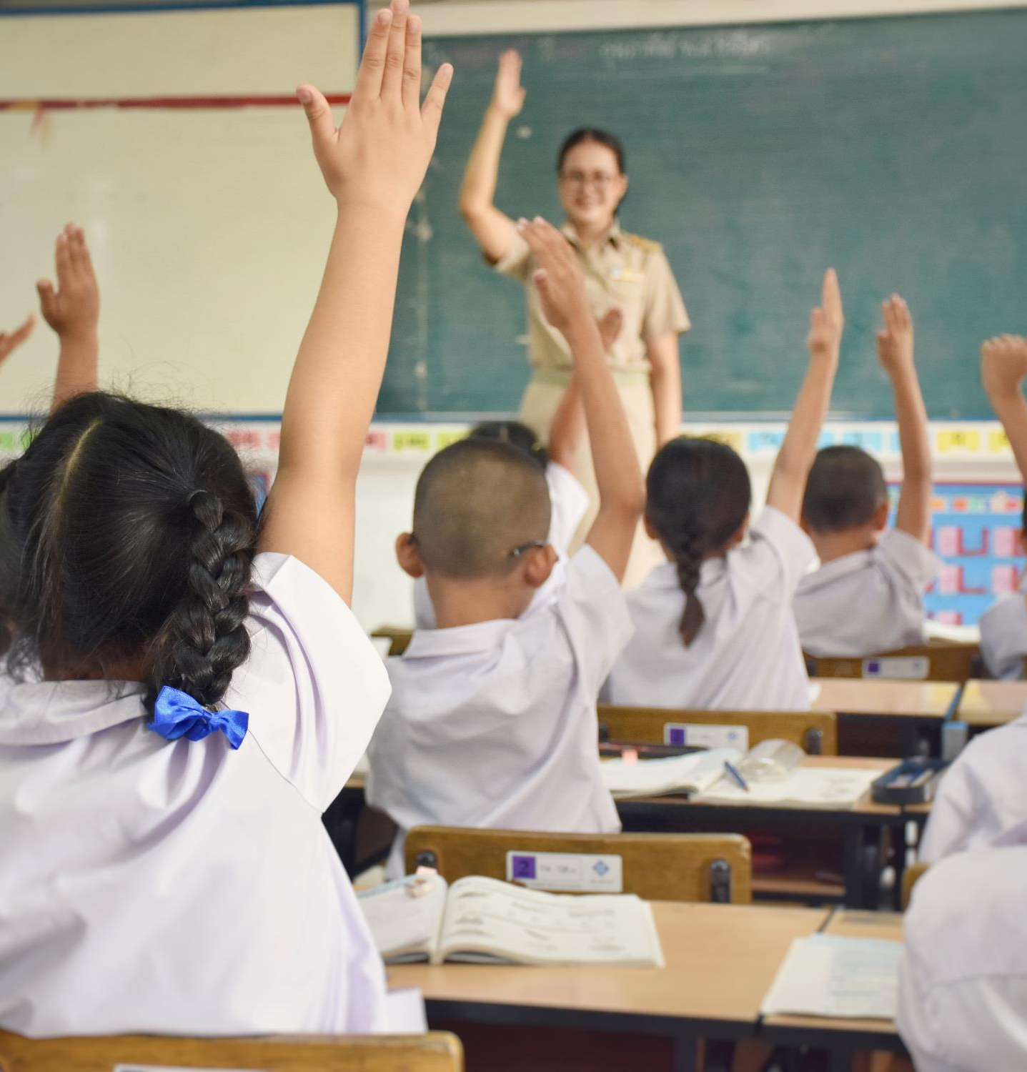
It’s time to come up with some ideas!
Ideas
  Take one pillar per group, and use the following slides to:
    think about your school’s main challenges (if you have done any research, this will help)
    think of some ideas for how you can tackle those challenges and make your school healthier.
Top tips
No idea is a bad idea at this stage. Be creative, and list anything that might be helpful or possible. Don’t worry about the details yet!
‹#›

Slide 20
Changing people’s behaviour
Ideas
  We are trying to change people’s behaviour – we want them to swap existing habits for healthier new ones! When you are coming up with ideas, think about EAST:
Make it Easy
Make it as easy as possible for people to make healthier choices
Make it Attractive
Can you make the changes fun
and appealing?
Make it Social
You’re more likely to get involved if
your friends are too!
Make it Timely
Choose the right time for change – e.g. the start of a new year
Notes:
Explain that when students help themselves or other people to be healthier, they are aiming to change behaviour. When brainstorming ideas, think about how can they make their aspect of healthy lifestyles easier, more attractive, social and timely?

Slide 21
Healthy eating and our school community
Healthy eating
Think about these questions:
What food is eaten at school and how healthy
is it?
Do students have snacks at school and are
they healthy?
How does what students
eat for breakfast affect
their learning?
Are students drinking enough water at school?
Does our community have enough information about healthy eating?
What are your school’s main challenges in this area?
Notes:
Briefly run through the pillar and examples with the class, before dividing into groups to brainstorm ideas
Support: Print and provide each group with their pillar’s slides as inspiration.

Slide 22
Healthy eating – your ideas
Healthy eating
Brainstorm ideas to help your school community to eat more healthily.
Example challenge
Example solution
We are eating too much sugar
Create a ‘sugar swaps’ leaflet for the school canteen and to take home.
We are not eating enough fruit and veg
Work with school cooks / caterers to add more fruits and vegetables to lunches.
We are not drinking enough water
Make colourful signs by the water fountains
Notes:
Click to reveal the example ideas to students to help them get started. Don’t limit students to what’s on the slide.

Slide 23
Getting active and our school community
Active lifestyles
Think about these questions:
How much sport do students
do in a week?
How much do students move around at playtime?
Are there sports or dance clubs students can join?
How do staff and students get to school and back?
How active are students
outside school?
Do students help parents and teachers to be active?
What are your school’s main challenges in this area?

Slide 24
Getting active – your ideas
Active lifestyles
Brainstorm ideas to help your school community to be more active.
Example challenge
Example solution
We don’t walk very much
Create a walking guide for your neighbourhood
Not all of us are very active at breaktime
Build activity spinners with active ideas
for playtime
We are not very active with
our families
Run family activity classes or a weekly child vs adult challenge, e.g. count how many times you can jump over a log in 1 minute
Notes:
Click to reveal the example ideas to students to help them get started. Don’t limit students to what’s on the slide.
Other example ideas:
Walking to school (or to work, or the shops) when safe and possible
Taking part in organised sports at school and in our community
Including other ways to exercise and be active, like exercise routines, being more active around the home and avoiding sitting too much in front of a TV, games console, computer or phone.

Slide 25
Mental wellbeing and our school community
Mental wellbeing
Think about these questions:
Do students know who to talk to at school if we
need support?
What things at our school can make people feel stressed and anxious?
Is there a calm place
students can go at playtime if they need to unwind?
Is there anything
that already happens
at school that helps
students’ mental wellbeing?
Are all students getting
the sleep they need?
How does not
getting enough sleep
affect students at school?
What are your school’s main challenges in this area?

Slide 26
Mental wellbeing – your ideas
Mental wellbeing
Brainstorm ideas to boost the mental wellbeing
of your school community.
Example challenge
Example solution
We are stressed about tests or exams
Use calming breathing techniques at the start and end of the day or between lessons
Some of us feel lonely
Have a ‘talking bench’ in the playground
We spend too much time on screens
Set up a mindfulness club with mindful doodling, calm jars, meditation and yoga etc.
Notes:
Other example challenges/ideas:
Enjoying socialising with friends who are kind to us
Taking time to relax
Getting enough sleep
Talking through our problems with someone we trust
Having a go at relaxation techniques like meditation or breathing exercises
Being more active, which is good for our minds as well as our bodies

Slide 27
Health and sustainability and our school community
Health & sustainability
Think about these questions:
What do staff and students do to support biodiversity
in this school?
Are staff and students eating local
and seasonal food
as much as possible?
How do staff and students handle waste – do they Reduce, Reuse, Recycle?
What green spaces
do we have?
Are staff and students travelling to school in an eco-friendly way?
Are staff and students saving energy where we can?
Are staff and students minimising use of things like single-use plastic and glitter?
What are your school’s main challenges in this area?
Notes:
You may wish to define sustainability or invite students to define or explain. One helpful definition is “meeting our present needs without limiting the ability of future generations to meet their needs” (adapted from ‘Our Common Future’, 1983 UN Commission on Environment and Development)

Slide 28
Health and Sustainability – your ideas
Health & sustainability
Brainstorm ideas to make your school community more sustainable.
Example challenge
Example solution
Our school doesn’t have any green space
Build a ‘wellbeing corner’ at your school
with lots of green plants
Not everything is recycled at lunchtime
Work with the caterers to Reduce, Reuse, Recycle
Some of our food travels long distances on planes
Create a vegetable garden to learn about local and seasonal food - and hold a competition to cook delicious meals with what you grow
Notes:
Other example challenges/ideas:
Supporting and enhancing biodiversity (the wide variety of life on earth and in any location or habitat) around our school
Changing how we generate and use energy away from fossil fuels and towards renewable energy sources that don’t contribute to climate change
Reducing the waste we produce as a school and instead reducing, reusing and recycling the materials we need
Creating and protecting green spaces in urban places where people can meet, socialise, relax, be active and enjoy better mental health

Slide 29

Session 3:
Action plan
Healthy School toolkit
Content: Selecting from your long list of ideas to create an Action Plan
Time: 30-45 minutes
Skills: Organisation, communication, leadership, teamwork
Notes:
Resources
Large sheets of paper and pens
Action Plan template on a computer

Slide 30
How would our ideas work in practice?
Action Plan
Divide into small groups and divide up the ideas from your last session.
WHO can this help?
All/some students
Teachers/staff
Families
Wider community
WHERE would this happen?
Assembly
In class
School hall
Playground
Outside school
At home
For each idea,
think about…
WHEN would this happen?
Before/during/after school Lunchtimes
Weekends
Holidays
HOW will we achieve this?
Make it an everyday habit
Give people information
Ask other people to help us (teachers/families/local businesses)
Notes:
Ask students to form groups of four to six and give each group a large sheet of paper (or they could use an online tool like Google Jamboard).
Explain that you’d like each group to think of at least six ways they could inspire and influence people. To help students, they should write down:
WHO they would like to help
WHAT change they would like to inspire
WHERE they would like to help this change to happen (for example at school, at home, in a community centre, at a cafe)
WHEN this change would take place (for example every morning at breakfast time, after school, on a Saturday morning when people meet up etc.)
HOW students will do this: will they make something easier, make it normal, give information, give reasons – or a combination of these?
Give students time to generate their ideas and then invite each group to share them (every student in the group should have a turn at reading out one idea). The ‘Brainstorm’ slide for each pillar will help students to get started.
Remind students that every school and community is different and a good idea will be right for the people students want to help. This might be a simple step, like starting a new activity in school or making fruit available each day. But if your school already does a lot in this area, the idea might need to be more challenging – for example, to work with other schools to share what you do and help them to do the same.
Now have a vote for the best idea to include in each group’s action plan: ask students to think of their top three ideas in their group’s plans and count the votes to find the most popular idea in each group. Invite each group to share their idea and note if any are the same as another group’s.

Slide 31
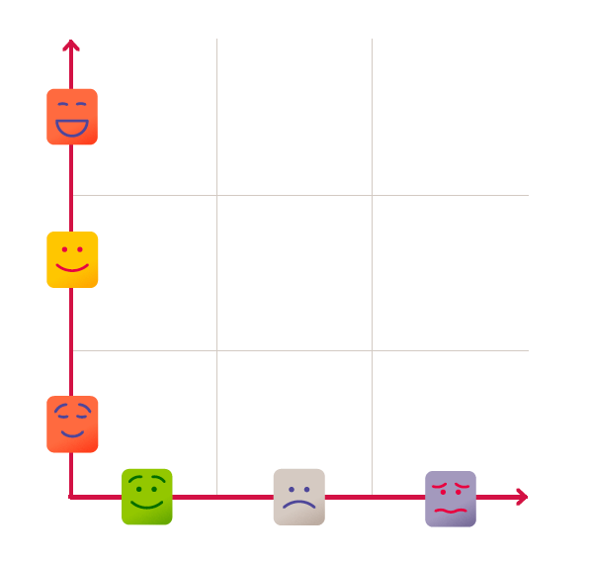
Idea selector
Action Plan
  Use the impact-difficulty graph to select the ideas that you will go ahead with.
  Choose ideas with a high impact that you might really be able to do.
Impact
Would have a huge impact
Top tips
Be realistic about how many difficult tasks you can tackle in one go!
Keep the other ideas as you might want to return
to them later.
Would have a medium impact
Would have a small impact
Difficulty
Easy to do
Hard to do
Impossible
Notes:
10 minutes

Slide 32
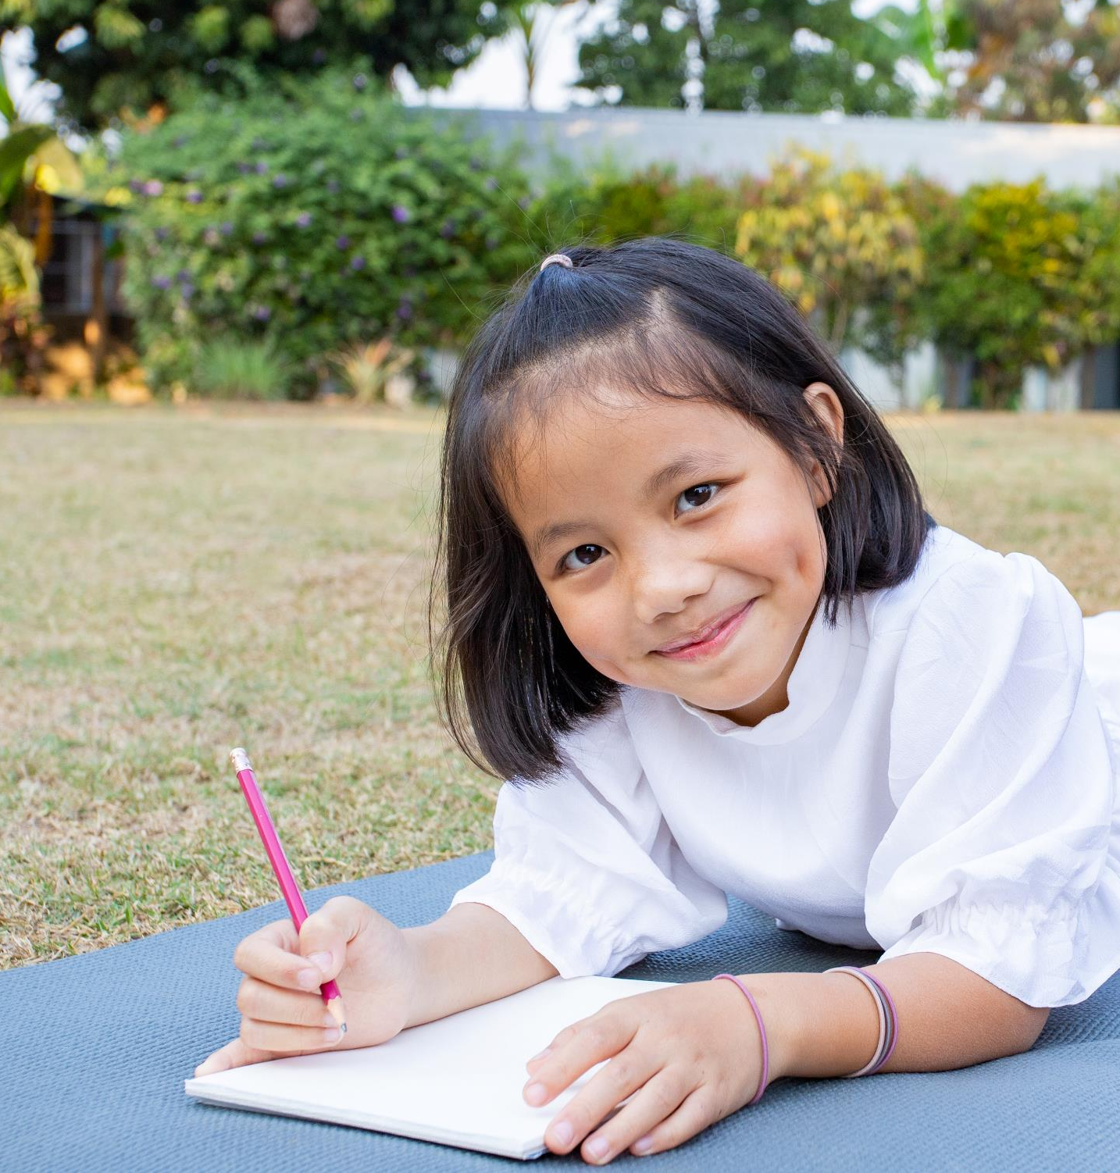
Creating your Action Plan
Action Plan
  Write down the ideas that you have decided to run with.
  For each idea, break down the steps that you will need to take.
  Think about:
    who will do what, when
    any help or resources you need.
Top tips
You can use the AIA Healthiest Schools action plan template if you wish!
‹#›
Notes:
Remind students that if they would like to help as many people as possible to be healthier (in body or mind), they need to have a plan.
Share copies of the action plan template and open a copy in your browser. Ask groups to divide up and create action plans for their ideas.
Ask students what it’s most important to first include in their action plan: the surveys and interviews – these will help students to make sure their ideas are good ones and to identify the best actions to take next.
Help students to complete an action plan template. One helpful way to do this is to start at the end and work backwards: ask students to imagine that their plan has been a success. What will people be doing? Then ask, ‘before that happens, what needs to have happened…’ and help each group to build a reverse timeline. They should end up with a list of steps to take to achieve their goal.
Invite each group to read out their action plan. Congratulate them on taking their first steps towards helping people to be healthier!

Slide 33


Further sessions:
Make a change
Healthy School toolkit
Content: Meet regularly to check on your progress
Time: 15-30 minutes for each meeting. To make real changes, aim to run your project over at least a month.
Skills: Organisation, communication , leadership, teamwork, perseverance, creativity
Notes:
Resources
Your Action Plan on a computer

Slide 34

Keeping going
Make a change
  You might want to book in regular meetings to look at your Action Plan, check progress and agree who will do what and when.
Top tips for progress meetings
Go through each item on your action plan
Check whether actions agreed at the last meeting have been completed
Agree any new actions
Make sure you are clear about who will be doing what, when.
‹#›
Notes:
Explain to students that if they want their plan to succeed, they will need to keep track of its progress and gather evidence of its successes – or failures. We can learn as much from the ideas that didn’t work as those that did work.
Enable the students to hold regular meetings, decide how often to have the meetings and write down an agenda.

Slide 35

Final session:
Share success
Healthy School toolkit
Content: Enter the AIA Healthiest Schools Challenge
Time: 60 minutes
Skills: Creativity, attention to detail, communication
Notes:
Resources
Entry form

Slide 36

Share your success
Share success
Entering is easy
  Your teacher will need to complete a form to tell us what you did to make your school community healthier.
  There are prizes for the best ideas, which will be shared with schools around the world to inspire them to make healthy changes too.
Be prepared
The form will ask about:
your school and your aims
who took part
what you did
the impact
what you will do next.
‹#›
Notes:
Introduce the AIA Healthiest Schools Challenge - this is a space for them to share evidence of their work and how its impact with schools across Asia Pacific!
Evidence could include:
Information from surveys with students, staff or others
Comments from interviews with students, staff and others
Photos or videos of the project
Images of student work with the resources

