Slide 1

AIA Healthiest
Schools
Assembly
An assembly introducing the fundamentals of healthy lifestyles and AIA Healthiest Schools.
Years: F–6
Time: Approx. 15–20 minutes

Slide 2
About AIA Healthiest Schools
Teacher’s notes
About AIA Healthiest Schools
  AIA Healthiest Schools is a program of free-to-use teaching resources for schools across Asia Pacific.
  The program provides lessons and workshops that help young people aged 5–16 to learn about healthy habits and to plan and implement changes that help students, their schools and communities to be healthier and happier.
Developed with teachers
  This program has been developed in partnership with Hark and a panel of subject matter experts and practising teachers.
Using this presentation
  The slides and slide notes include all the subject knowledge you’ll need to teach this topic with confidence.
  Slide 2: Overview for teachers.
    Hidden slides will not display in presentation mode.
  Slides 3–14: Slides to adapt and use with students.
    Some slides have animation. View them in presentation mode to see all content.
    Slide notes contain further teacher guidance.

Slide 3


Welcome to AIA
Healthiest Schools
Welcome
Learn with schools across Asia Pacific!

Slide 4

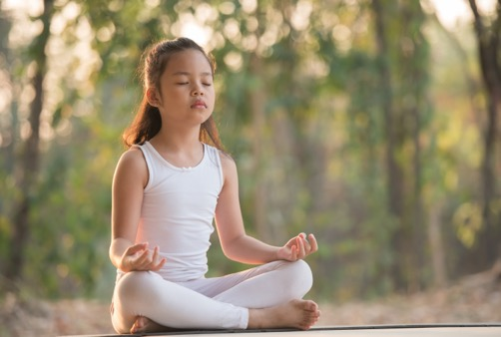
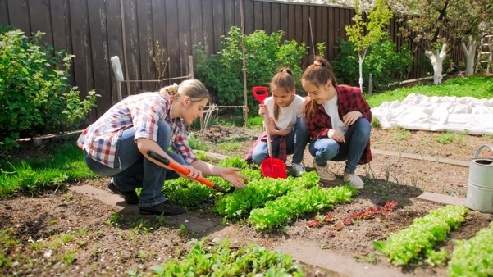

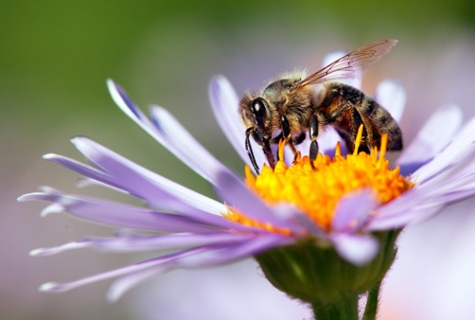


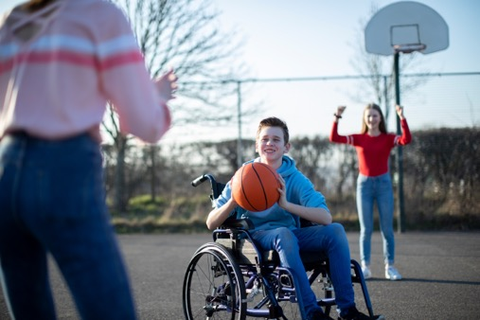
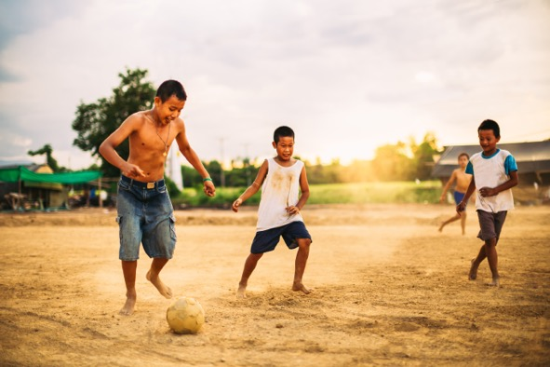
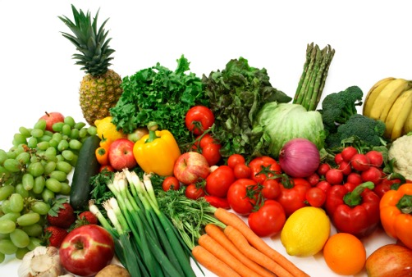
What does ‘healthy’ mean to you?
Assembly
Notes:
Explain that this assembly is about being ‘healthy’ – what does it mean and why does it matter?
Invite students to share their definitions/ask them to stand or punch the air for the picture that best represents being healthy to them.
Emphasise that being healthy is all about balance. All of the images on the board represent being healthy in different ways, our challenge is to mix them together in a way that works for us as individuals.

Slide 5
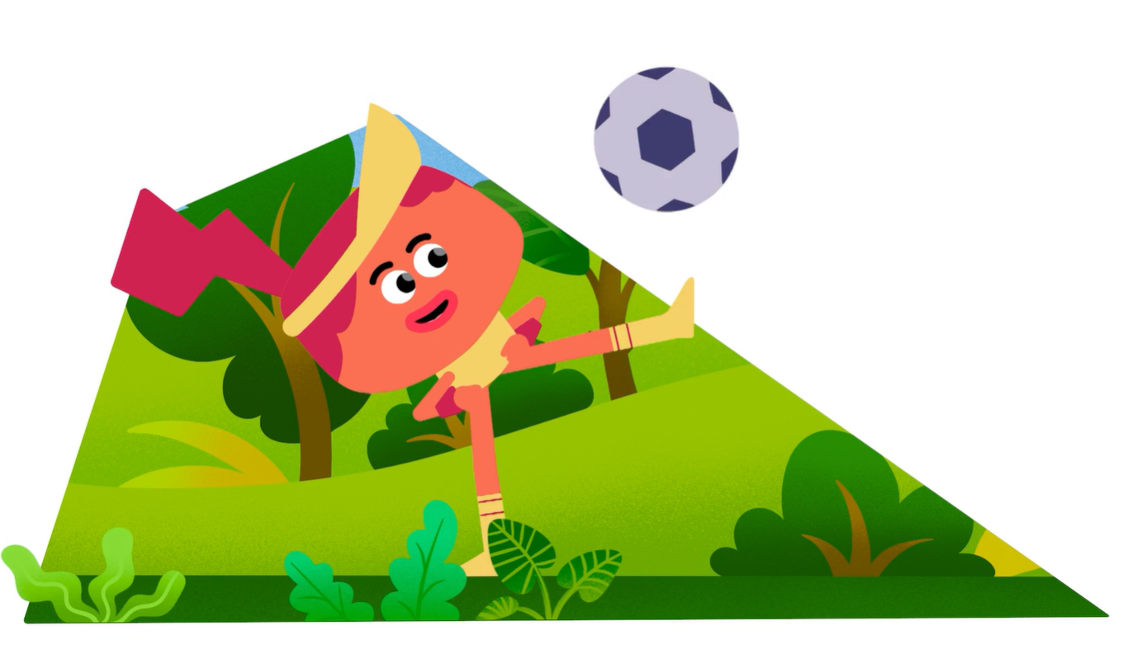
Finding a balance…
Assembly
What healthy choices
do you see?
Notes:
Ask students to wave their arms/jump up when they see a healthy behaviour.

Slide 6








Healthy body, healthy mind, healthy world
Assembly
Every day we make choices that can help us to…
….eat well
….move more
...look after
our minds
…and keep our planet healthy!
But how do we know we are making the best choices?
Notes:
Review our four characters – together they form a balance of a healthy lifestyle. Being healthy means thinking about everything together – healthy eating, an active lifestyle, looking after our mental wellbeing, and including sustainability when we think about our health (a healthy planet provides the food, clean air, water and green spaces we need to stay healthy – a healthy planet means a healthy us!).

Slide 7
Let's learn together
Assembly
With AIA Healthiest Schools, we will work together to build a healthy community.
We’ll help you learn how to make healthy choices
… create time
and space for
being healthy
… tackle the challenges life can throw our way…
… and help others to do the same!
Notes:
Explain that your school is taking part in the AIA Healthiest Schools Program. AIA Healthiest Schools will help every student to think about what health means to them, and to plan, carry out and track helpful changes that help them to become healthier in all of these four areas.
AIA Healthiest Schools will include learning in some new lessons, a daily activity, some home challenges, and helping your community too.

Slide 8




We’ll ask questions …
Assembly
What would help me to move more every day?
Why do we need our planet to be healthy for us to live healthy lives?
We all know fruit and veg is good for us – what would help me to eat more of it?
How do I manage different feelings?
Notes:
The activities will help students to ask important questions, like these.

Slide 9
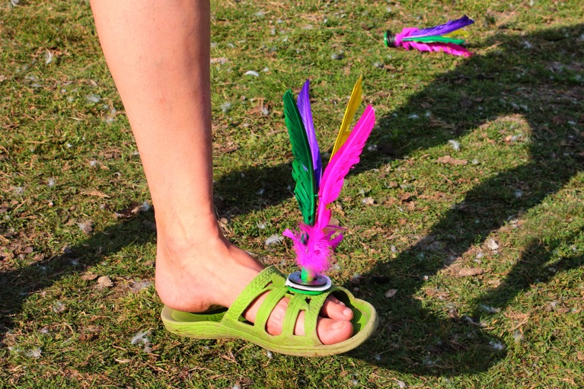

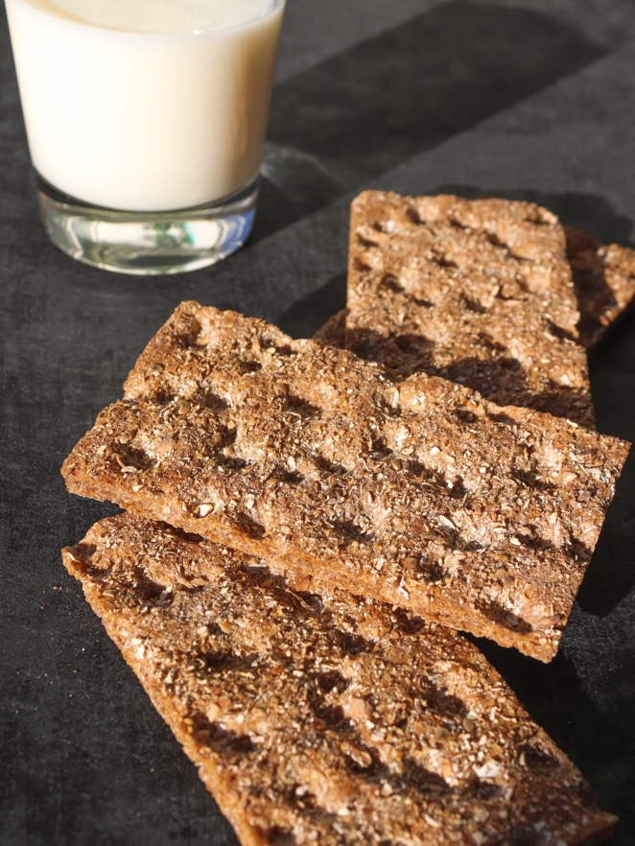

Learn from others around the world…
Assembly
How do different people get active?
What healthy snacks can we find in other countries?
What can we learn about mental wellbeing?
What would help me to move more every day?
What do sustainable spaces look like around the world?
Notes:
They will explore different approaches to being healthy from around the world.

Slide 10
Discover how to make changes that last…
Assembly
For example: Healthy changes are more likely to last if you think EAST:
Make it Easy
Make it Attractive
Make it Social
Make it Timely
Notes:
They can discuss how to help their school become healthier with the AIA Healthiest Schools Challenge. How can you create opportunities and remove challenges?

Slide 11
And put our learning into practice to help ourselves...
Assembly
I’m eating more
fruit and veg!
I’m being
more active!
I know how
to stay calm.
I’m helping to keep our planet healthy!
Notes:
The AIA Healthiest Schools program isn’t just about learning facts, but putting learning into action to make a real difference in everyone’s lives.
We’ll all learn what we can do to be healthier and we’ll help each other on our journeys.

Slide 12
… and others to be healthier as well!
Assembly
Make your
school healthier
Share your ideas with your community
Show us how you’re helping others
… and maybe win some amazing prizes!
Notes:
The AIA Healthiest Schools program isn’t just about learning facts, but putting learning into action to make a real difference in everyone’s lives.
We’ll all learn what we can do to be healthier and we’ll help each other on our journeys.

Slide 13


What we’ll do next
Assembly
Learn how to be healthier
Reflect, ask and share
Bitesize activities and home challenges
Plan how we can help others
Help others be healthier
Share our successes
Notes:
Adapt this slide to support your specific plans for taking part in the AIA Healthier Schools program and Competition.
Use the diagram on the slide to explain how the process will work in your school as students take part in the lessons, generate ideas and create action plans to inspire and support other people, help everyone to be healthier and happier, and then share your successes in a great submission to the AIA Healthiest Schools Competition.
Finish by posing these questions. What one thing could you do today to help build your own health and wellbeing and one thing to help make our school a healthier place?
Working together as a school, we can all look after the health of our bodies, minds and our planet!

Slide 14



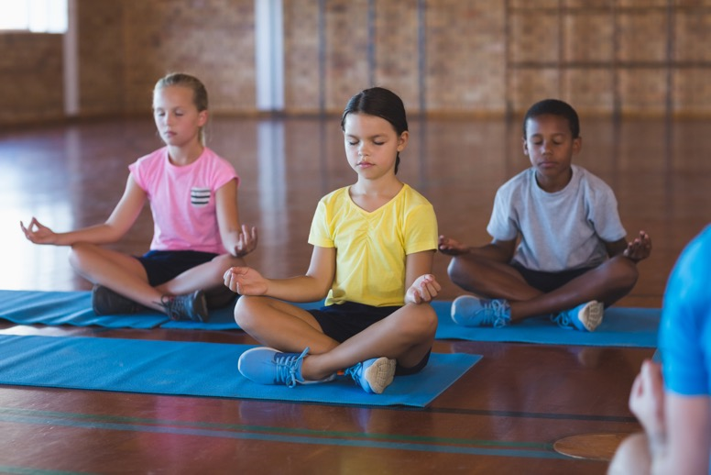
Let’s get started! How will we become a healthy school?
Assembly
Let’s help each other to be healthier.
Notes:
Explain that it’s important to ‘start where we are’ as a school and as a community.
And it’s really important to understand that we are all different. We all might start from different places when it comes to our health or happiness, and we might want to do different things to improve them. It’s not about where we start from or where we get to, but about how far we can go together as we make helpful changes in our own lives and then inspire and help our friends, families and community.
Ask students: Being healthy is looking after our bodies and minds to be the best we can be! Who is ready to make changes to help themselves, their friends, family and community?
Time permitting finish the assembly by following along with a short active routine – selecting an option to fit the space available.

