Slide 1
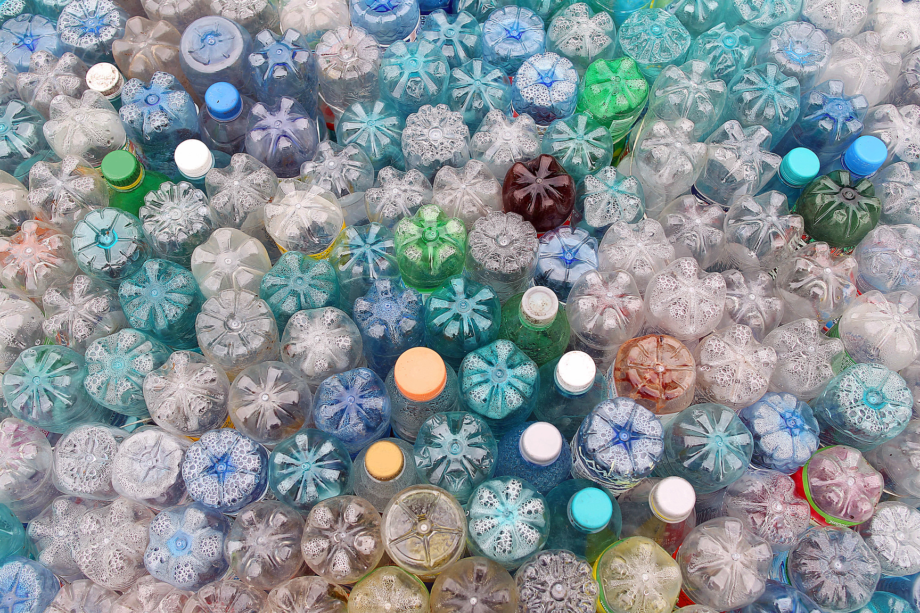


Short Films for Behaviour Change
Get ready to make change!

Slide 2


