Slide 1
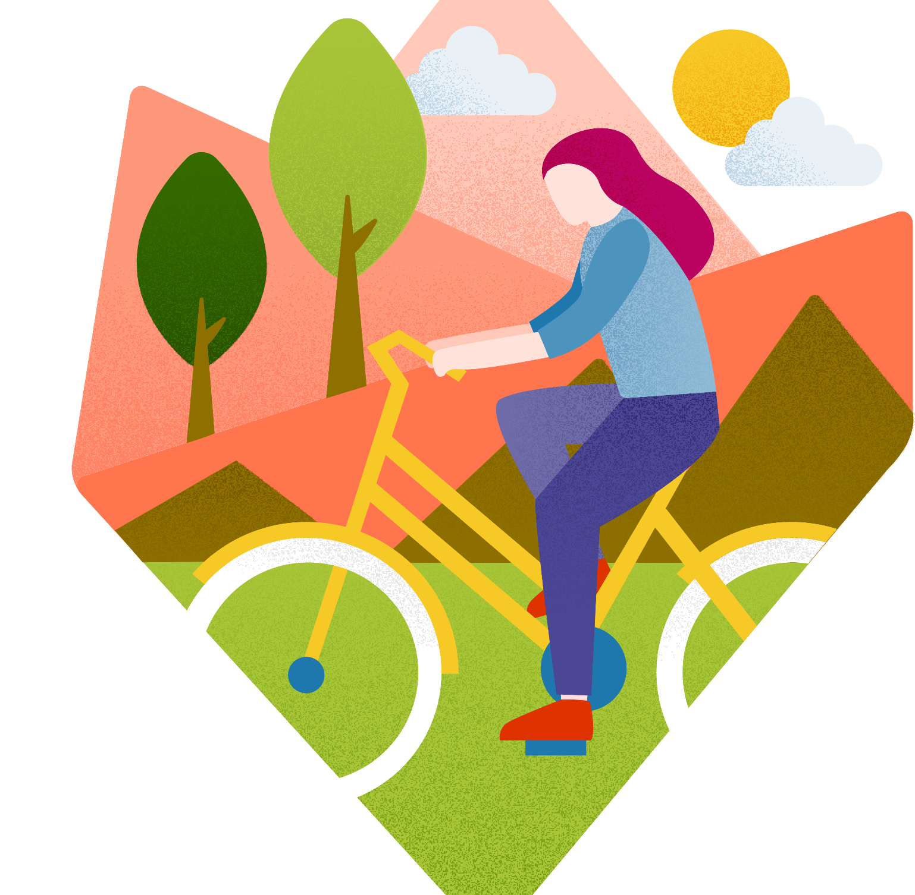

Get moving!
Active lifestyles
What is ‘getting active’?
How does it help?
Find out what it means to get active, how it helps us and create an active school routine.
Subject: HPE, English
Years: F–2
Time: Approx.1 hour
or 2 x 30 minutes
Time: Approx.1 hour
or 2 x 30 minutes

Slide 2

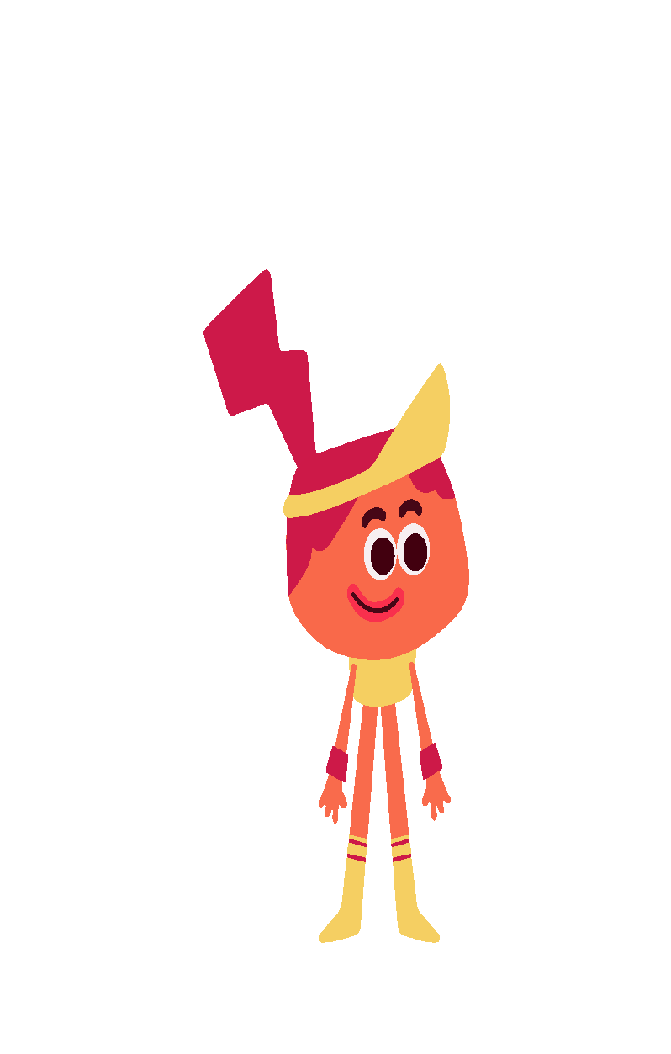
Welcome to AIA
Healthiest Schools
Welcome
Learn with schools across Asia Pacific and help build a healthier world!

Slide 3
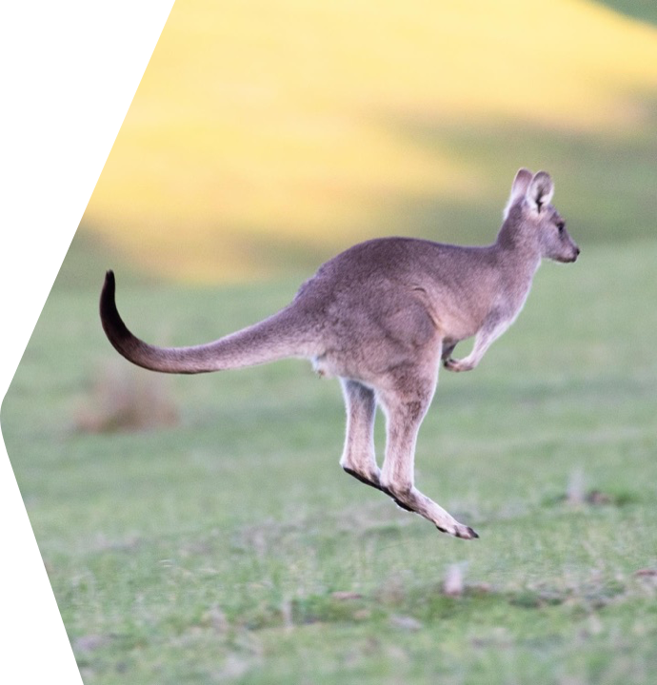

Kangaroo-play
Starter
Keentan is a ball game from Australia.
It is called ‘kangaroo-play’ because players jump up high.
Let’s play!
Notes:
Here is a fun power-up activity that will get students moving! Instructions are below. While playing the game, bring their attention to how being active makes them feel.
Keentan is a traditional keep-away catch ball game played in northwest central districts of Queensland, Australia. The Kalkadoon people sometimes called this game ‘kangaroo-play’ or ‘kangaroo ball’ because players must jump up high… like a kangaroo!
One team passes the ball while the other team tries to intercept, by catching the ball when jumping with both feet off the ground. Due to these small jumps the Kalkadoon people sometimes described this game as the ‘kangaroo-play’.
How to play:
Split the class into two teams. One team starts with a ball and must pass it around their teammates.
The opposing team must try and intercept the ball whilst it is in the air.
The ball can be held for three seconds and must be thrown while the player is in the air.
Teams pass the ball while the other team tries to intercept, by catching the ball when jumping with both feet off the ground.
Set a five-minute timer. The team who makes the most passes of the ball is the winner!
Support: Adapt the actions as needed for your students’ needs/space available.
Challenge: Can students think of any other games related to animals? Or other traditional games from around the world? (For an example see the extension slide!)
Sources
https://www.sportaus.gov.au/yulunga?result_704748_result_page=3
https://www.sportaus.gov.au/__data/assets/pdf_file/0010/704854/keentan.pdf

Slide 4
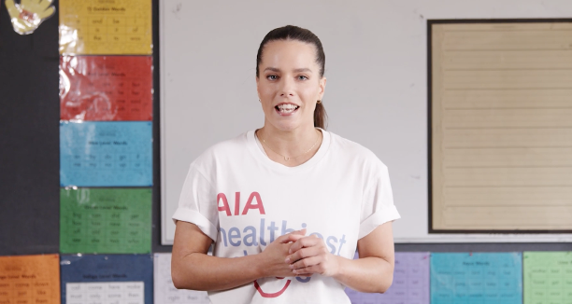

Let’s get moving
Starter (option 2)
Watch our video with Olympic diver Anabelle Smith.
Watch the video and try Anabelle’s active routine!
What other ways of getting active can you name?
Notes:
Alternatively, start the lesson by watching our interview with Olympic diver Anabelle Smith and follow the movements.

Slide 5
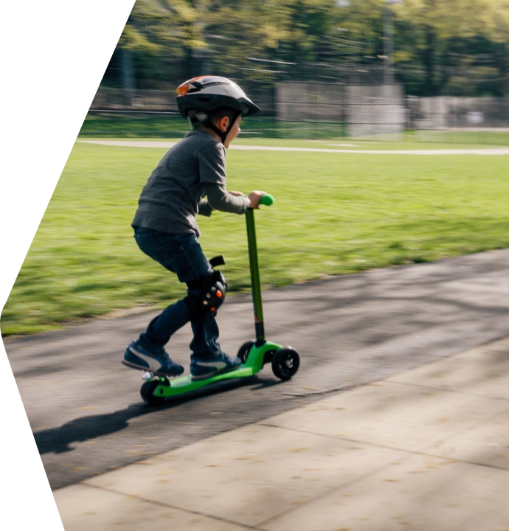
Get moving!
Learning outcomes
Learning objective
  I will learn about what getting active means, how it can help and fun ways to get moving!
Learning outcomes
  By the end of the lesson, I will be able to:
    list ways to get active
    describe how getting active makes my body and mind feel
    list benefits of getting active.
    create an active routine.

Slide 6
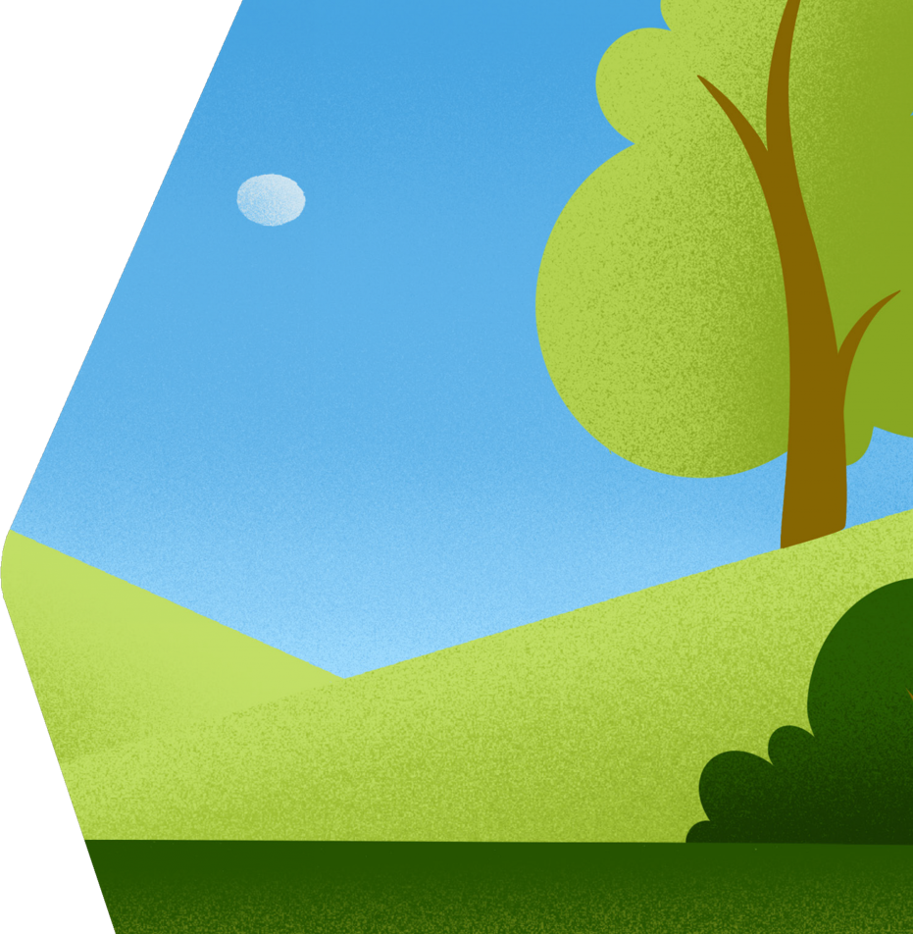
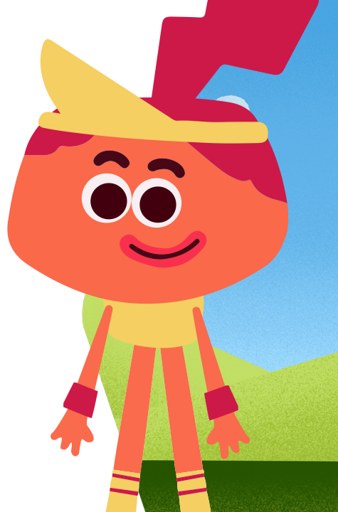
Hello!
Starter
Baseline
Getting active is good for us.
But what does it mean?
Notes:
Ask students for some suggestions before moving to the next slide.

Slide 7
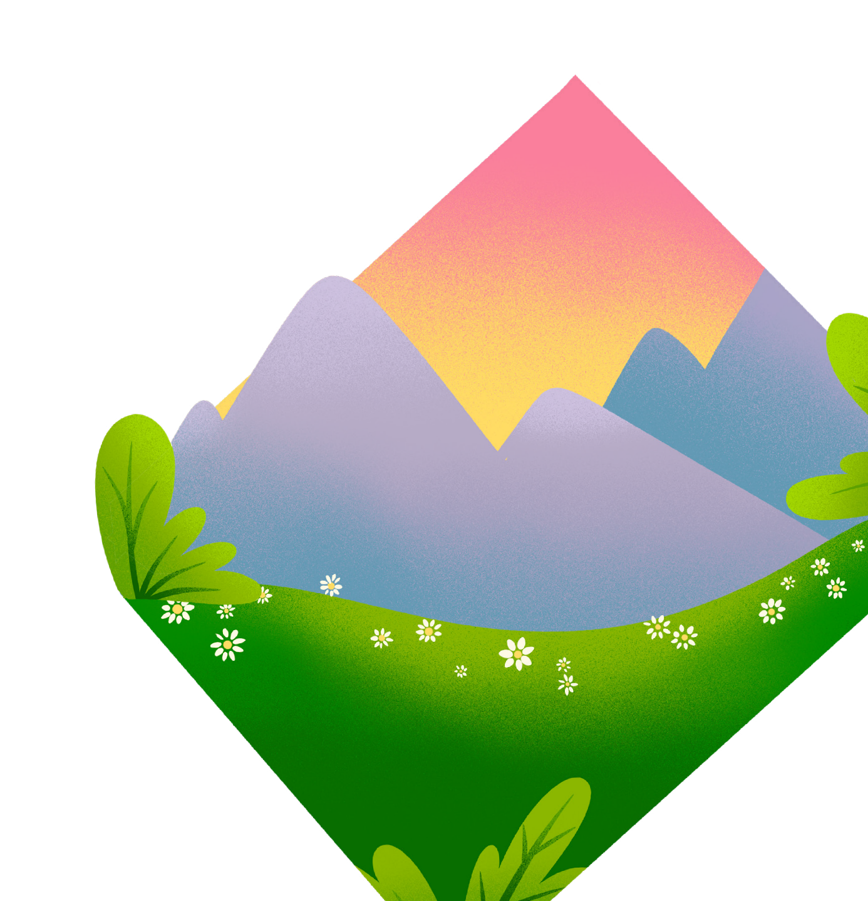
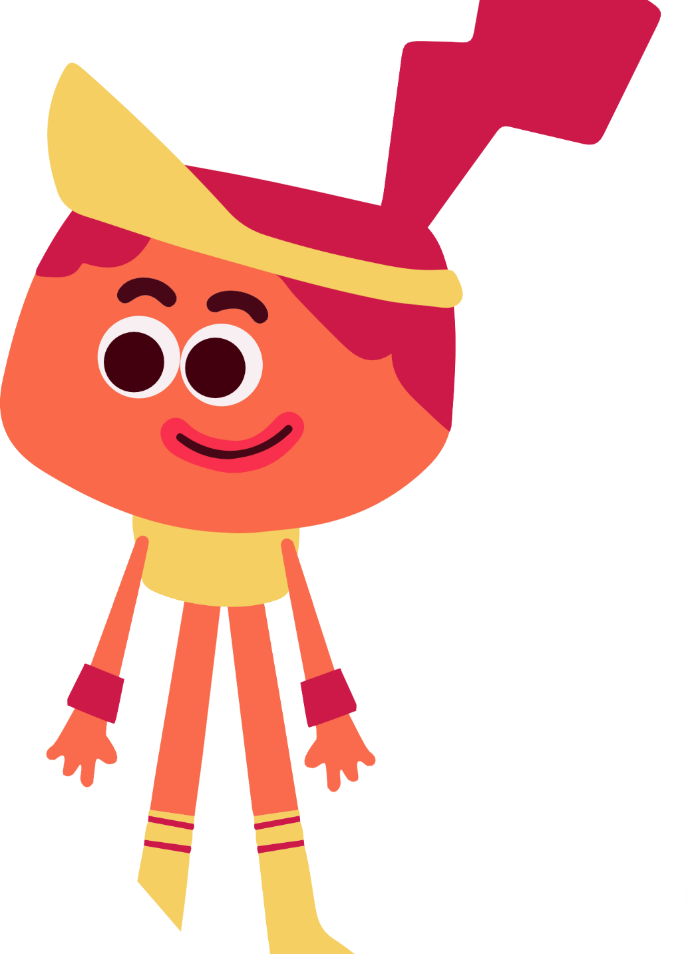
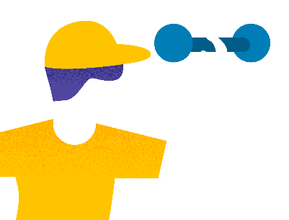
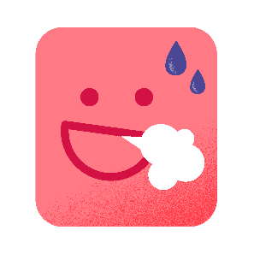

Getting active means…
Activity 1:
Getting active
…moving your body!
At least 60 minutes!
Huff and puff!
Less screen time!
How do you get active?
Notes:
Review the recommended guidelines for physical activity for children aged 5–17, with students.
At least 60 minutes of ‘moderate’ to ‘vigorous’ (or ‘very active’) physical activity a day – this is activity where you breathe (huff and puff) and your heart beats faster. You should do some light exercise as well.
It is also important to do some exercises to keep your bones and muscles strong (E.g. Climbing trees, playing on monkey bars, running, helping to carry shopping, yoga etc!).
Remember getting active is not just about sport – you just need to find ways to move your body that you enjoy and that make you huff and puff!

Slide 8
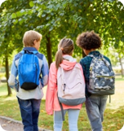
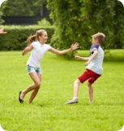
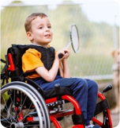
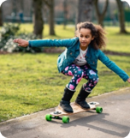

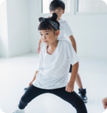
Who’s getting active in each picture?
Activity 1:
Getting active
Not active | Active | Very active
Sit and slouch | Walk on the spot / sway your arms slowly | Run on the spot/ punch your arms in the air
Notes:
Introduce key terms – sedentary (not active), active (moving but feeling fine) and very active (huffing and puffing, hot and sweaty) – and confirm the meaning through active mime.
Remind students they should try to do lots of both very active and active activities!
Support: Students with physical disabilities can indicate their answer by holding up 1 (sedentary), 2 (active) or 3 (very active) fingers.
Challenge: Ask students to suggest other activities for the class e.g. climbing trees, swimming, sweeping the house. What activities could help them get strong? (E.g. Yoga, climbing trees, playing on monkey bars, running, helping to carry shopping etc!)

Slide 9




Why should we get active?
Activity 2:
Why get active?
Let’s think about how
it makes us feel!

Slide 10
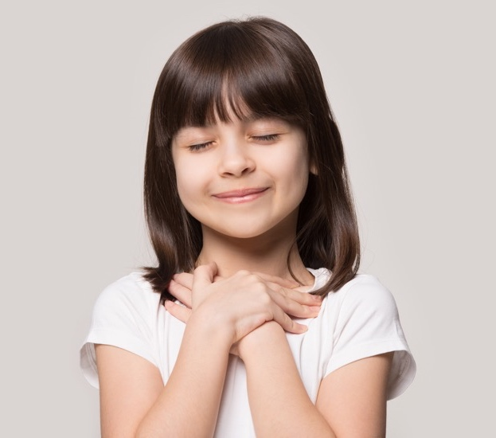
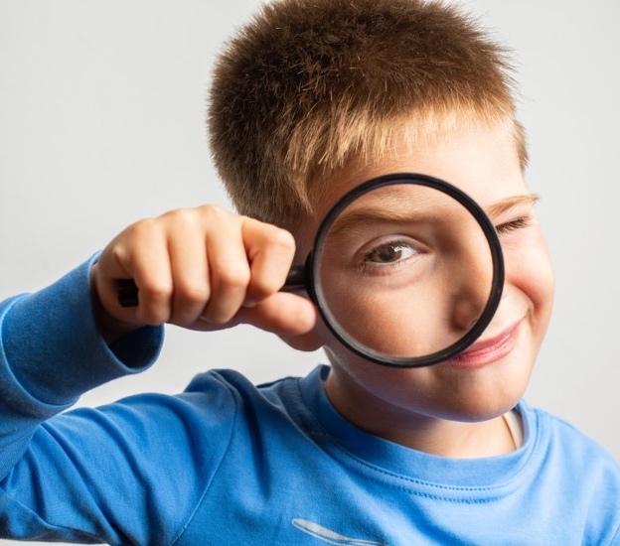
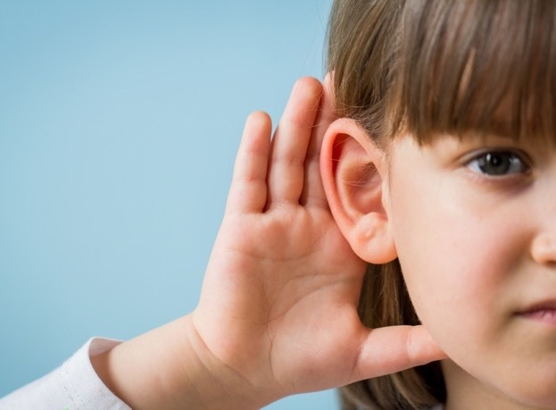
How does getting active make us feel?
Activity 2:
Why get active?
Do each activity for one minute.
Glide like an eagle
Crawl like a caterpillar
Hop like a rabbit
After each activity:
Extension
What do you feel?
What do you see?
What do you hear?
Notes:
Introduce the task – students are going to investigate what changes they feel/see/hear after different activities.
Ask students to complete the first animal-themed movement ‘glide like an eagle’ for approx. one minute.
Repeat with the next movement (crawl like a caterpillar).
Repeat with the next movement (hop like a rabbit). Students should feel different sensations in their body and different feelings for the different exercises.
Encourage students consider:
What do you feel? (e.g. getting hotter, feel sweaty, heart beating faster, calmer)
What do you see? (e.g. red cheeks)
What do you hear? (e.g. heavy breathing)
Discuss as as a class, or students could work in groups and draw/write their answers on the body template worksheet. This will help students discuss how they feel during each activity (e.g. gliding like an eagle feels calm – write this on the head for calm mind, arms feel loose/not tense).

Slide 11

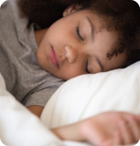
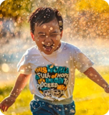
Match the benefit to the picture
Activity 2:
Why get active?
Better mood
Healthy brain
Helps you sleep
Notes:
Ask students what kind of changes they observed, before revealing the key benefits of exercise. How does this fit with their observations? (E.g. felt happier, exercise impact mood, felt their heart beat faster, exercise helps keep your heart healthy.) If students have used the template - ask them to add the key benefits to their sheet.
More information:
Better mood – exercise releases chemicals called endorphins, which can make you feel happy and energised. Slower exercises and deep breathing can also help calm you: every breath sends millions of messages to your brain, so slowing your breathing can slow this down and help you think more clearly.
Brain health – exercise creates new connections in your brain (neural pathways) which helps keep your brain healthy. This can help you concentrate and help your memory.
Helps you sleep – as well as slow exercises to calm you down, high-energy exercise earlier in the day can help you get to sleep faster and sleep for longer at night.

Slide 12
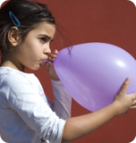
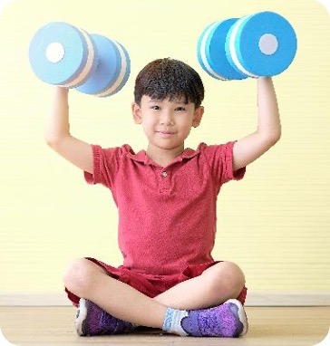
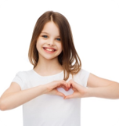
Match the benefit to the picture
Activity 2:
Why get active?
Strong heart
Healthy lungs
Strong bones and muscles
Notes:
More information:
Stronger heart – your heart is a muscle too and exercise makes it stronger. This reduces the chance of diseases like heart disease in the future and helps improve how your blood flows around your body, carrying all the oxygen you need to different parts.
Stronger bones and muscles – makes your bones stronger. This is particularly important for children and young people as you grow.
Healthy lungs – helps with breathing, making sure you get the oxygen you need.

Slide 13

Design a routine for your class
Activity 3:
Create an active routine
Choose four to six action cards.
Practise!
Tip:
You should huff and puff!
Your heart should beat faster!
Notes:
Ask students to work in groups to design a short exercise/dance routine that could fit into the school day. Provide students with some music and the Routine designers cards, which they can sequence to create their own dance routine.
Challenge: Students can use the Our active routine worksheet to record their routine, or simply plain paper.

Slide 14



Plenary
Plenary
What did we learn today?
Wow! Great work!
What did you
enjoy most?
What else would
you like to learn?
What next?
Take the AIA Healthiest Schools Challenge
Share your routine
with others!
Notes:
Ask students to think, pair and share to reflect on the lesson.

Slide 15
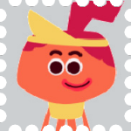
Postcard to me
Plenary
Draw or write what you want to remember, share or find out!
Get moving!
Healthy eating • Active lifestyles • Mental wellbeing • Health and sustainability

Slide 16
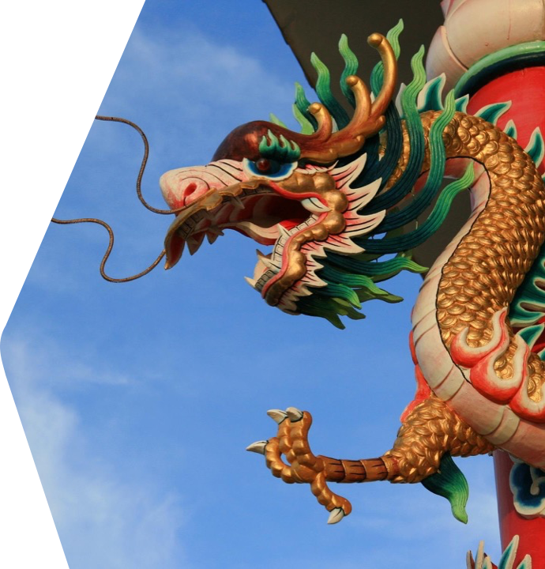
Ngoo Kin Hang/Tail-Eating Snake
Plenary
Choose one mother snake and one father snake. Everyone else is a baby snake.
Babies line up behind the mother – hold the waist of the person in front.
The father tries to catch the baby snake at the end of the line.
The mother and babies move in their snake-like line to avoid him!
Notes:
Traditionally played in the Songkran (water splashing) festival in Thailand.
How to play:
Divide into two teams - father snake and mother & baby snakes.
Line up with players hand on waist of person in front.
Father and mother snake traditionally recite set words before starting (short version below!)
Father snake: Dear Mother Snake.
Mother snake: Yes, Father Snake.
Father snake: From which well do you drink?
Mother snake: I drink from a well in the stone and we fly here and there.
Mother snake: Are you going to eat the head or the tail?
Father snake: Should I eat the head of the tail? I’ll eat the whole body!
Father snake then tries to catch the baby snakes at the back of the mother’s line. The mother snake tries to protect them with her arms out/moving in a snake like line.
Any ‘baby snakes’ tagged/pulled out of the line are out. Play with a set time limit, or until no baby snakes left!
Tip: Keep the teams fairly small to avoid overly long snakes. Remind students to leave the chain if they are caught or they stumble - no hanging on once caught!
Source:
https://www.unesco.org/archives/multimedia/document-3168

Slide 17
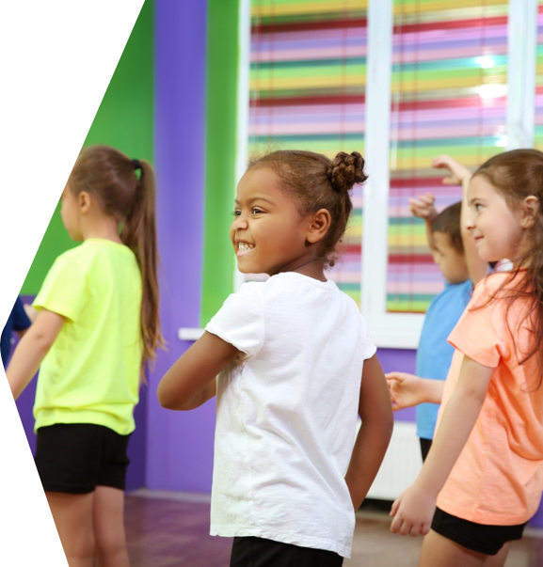
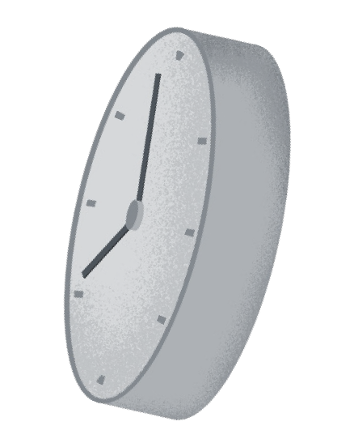
Ideas to try at home
Home Learning
Show your family your routine.
Get everyone to join in!
Can you make them huff and puff?

